Slide 1
PV 7717 In-house Appworks
Siu Wong aka Ethan
6/2/2021
1.1 Final
Link to Solution Approach Guidance

Slide 2
Town: Borrow Money
The business is exiting its relationship with Anovaa/Entech. This initiative is to bring on-prem Appworks student/perl data & documents stored currently stored in the Sungard data center before June 1, 2022.
Mission: The business will need access to the historical data to satisfy future auditor, regulatory or lawsuits. CFG will bring any data and documents residing in the Sungard data center in house. Citizens also owns the infrastructure and OS/Software licenses and will decommission the infrastructure and related software in the Sungard data center.
Network connectivity from CFG to Sungard
Database/documents in house
Engineer new interface into the on prem data store or use existing DB
Decommission Sungard infrastructure
Standup intermediate ORACLE database on prem
Port ORACLE db to PostgreSQL to eliminate ORACLE dependency
Engineer new interface & API layer inclusive of document retrieval. Target AWS Consumer Lending
AWS P-2 Environment
RDS PostgreSQL, OpenShjift, Spring boot API Layer. React UI, S3 Storage of documents
AWS Environments P-1, P-0
Ingestion of loan disbursements into LaaS for loans disbursing post 12/31/2021. Source of extract will be Sungard data store and provided by Anoova
Future support of student loan sales post 12/31/2021. Providing data extracts, documents, etc.

Slide 3
Planning
Phase 0 ~ Prerequisites
Scope: Encompasses all the necessary groundwork required to enter into Phase 1 such as Anovaa
Alignment, Resources, Project/POD Formation.
Target Timeline: 4 – 6 Weeks
Phase 1 ~ Options & Analysis
Scope: Analysis to determine best option for Citizens Bank to assume support for Appworks
from Anovaa in order to support business requirements to retrieve documents and data
for audit, regulatory and asset sale inquires
Target Timeline: 8 – 12 Weeks
Options Under Consideration
Migration of Data + Creation of Basic Queryable Interface (AWS)
Update June 2: This option was selected by the business.
Lift & Shift of Lender Web Application & Data to AWS/CFG On Prem
CFG Support of Appworks as-is at Sungard
Other: Hybrid
Feature Prioritization & Sequencing
Phase 2 ~ Execute Option
Scope: Execute Option 1
Target Timeline: 3 – 6 Months
Phase 3 ~ Decommission of Sungard
Scope: Decommission of Sungard Hardware in 2022
Target Timeline: 6 - 8 Weeks

Slide 4
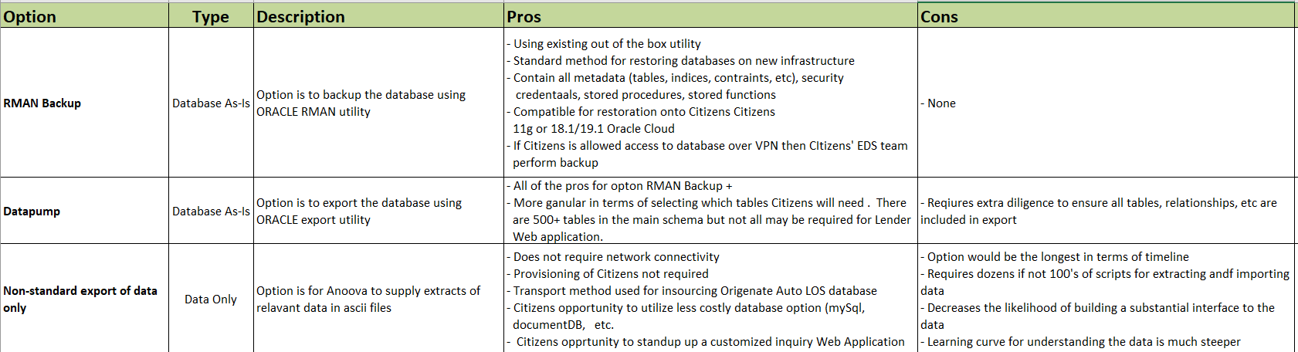
Options for Obtaining Data
Update June 2: Option 1 RMAN Backup is selected

Slide 5
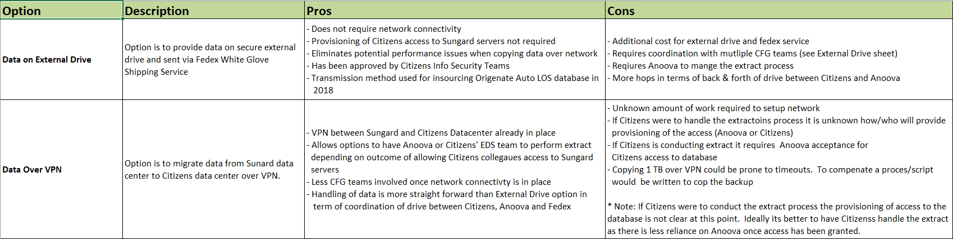
Options for Transmitting Data
Update June 2: Option 1 is selected however we are using a Synology NAS Device which has been approved by CS&R Data Protection Team

Slide 6
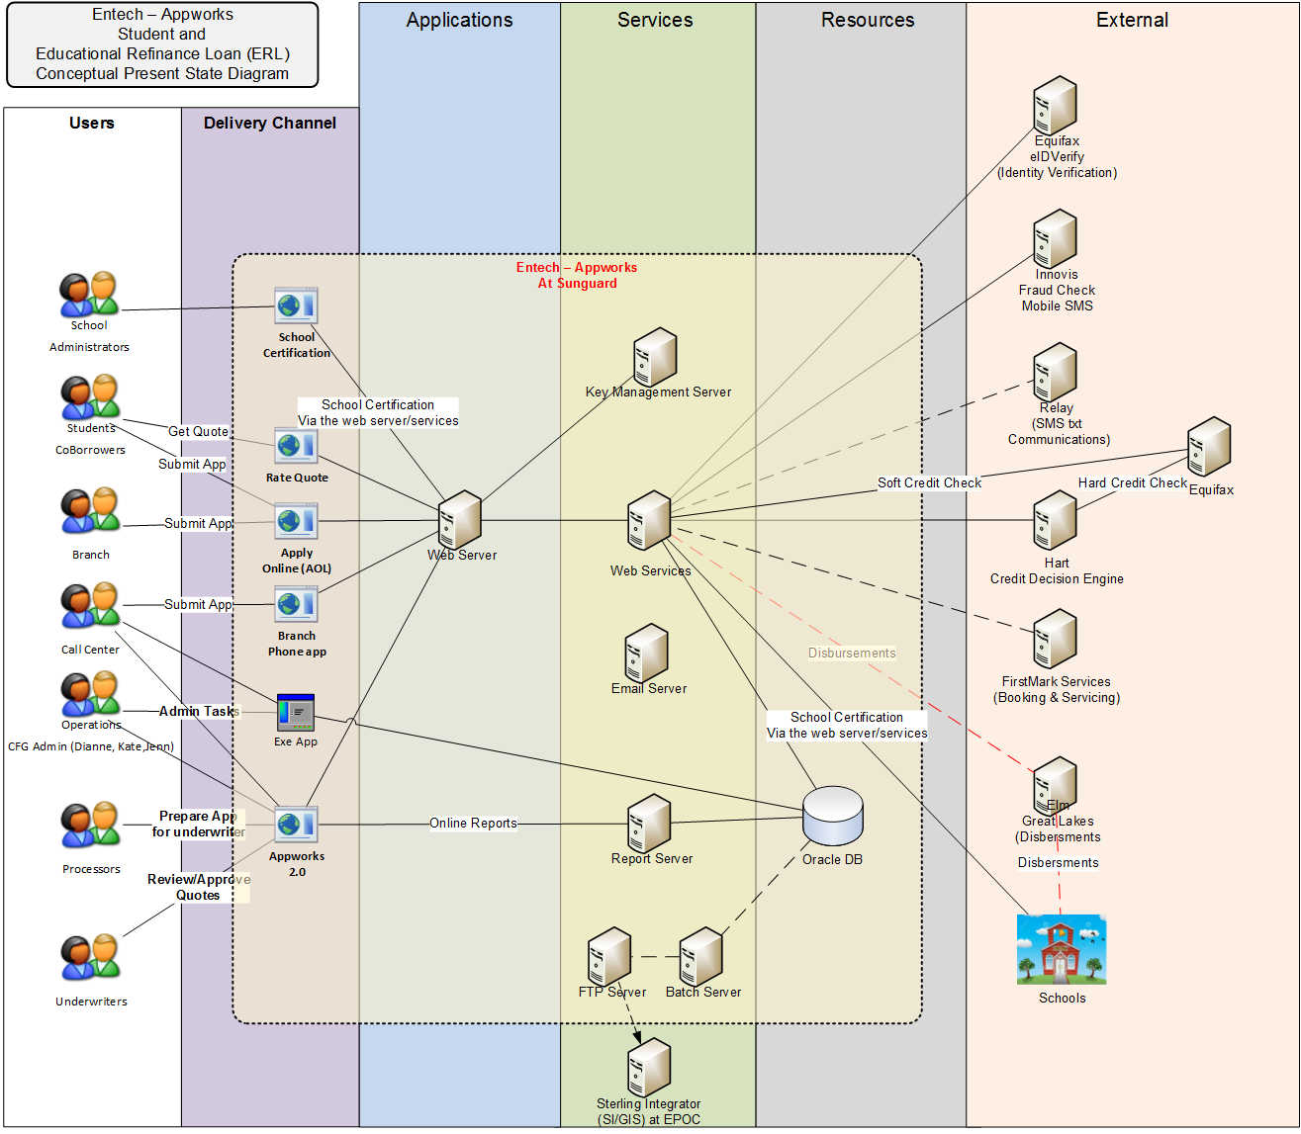

Slide 7
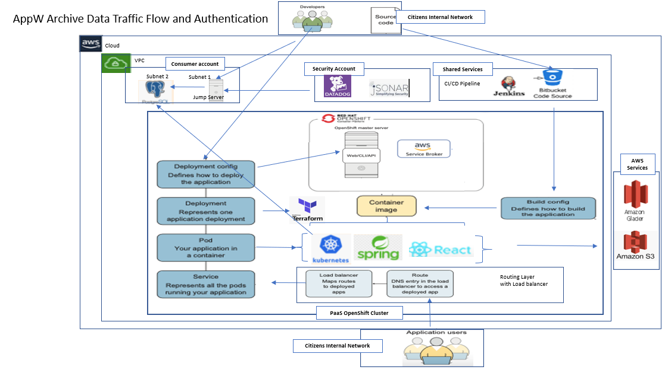
Conceptual Overview Diagram

Slide 8
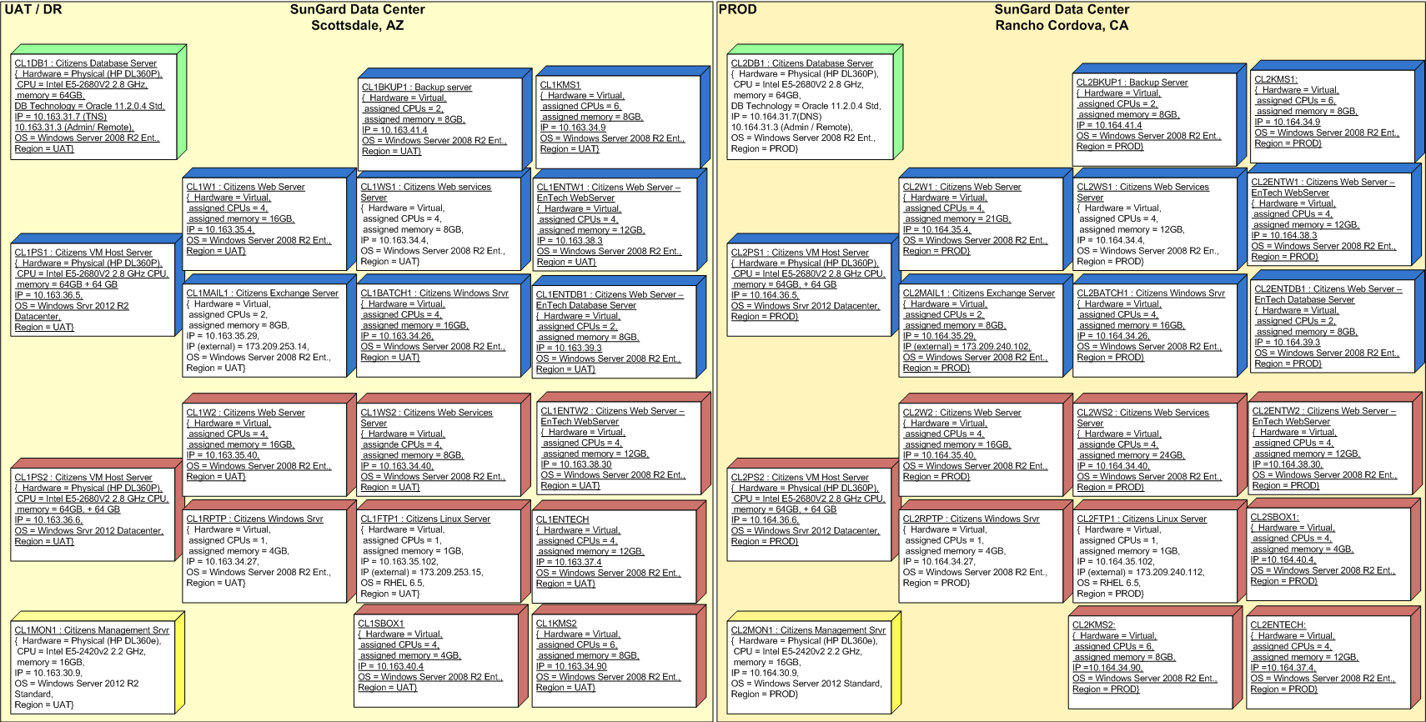
As-Is Architecture: Sungard Physical

Slide 9
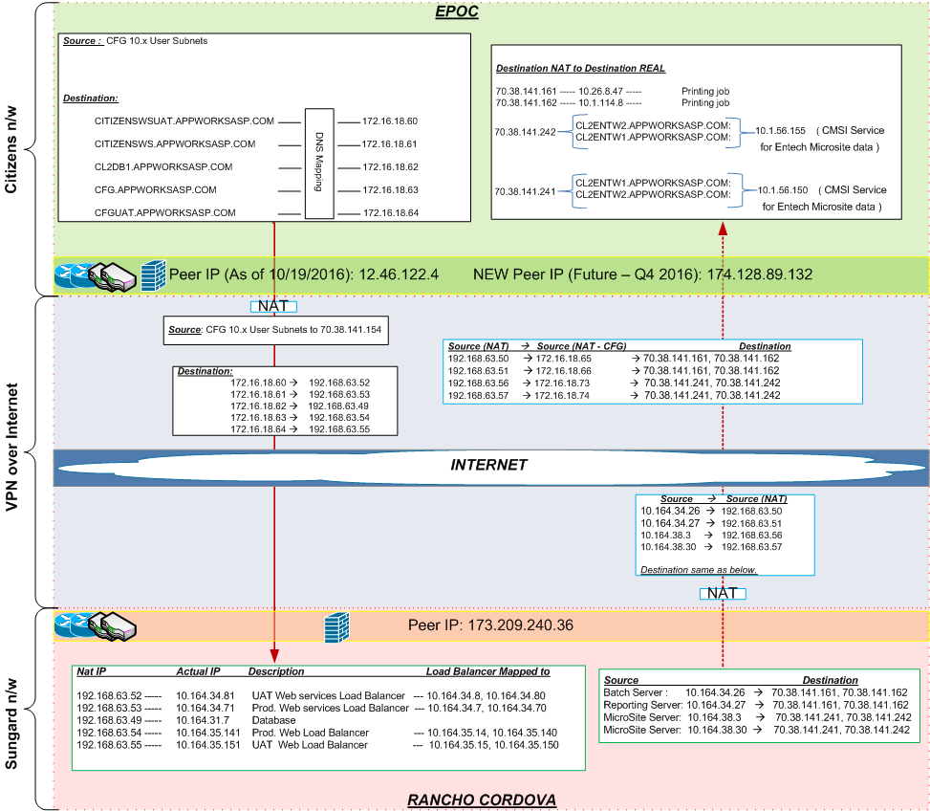
Network Infrastructure: EPOC <-> Rancho

Slide 10
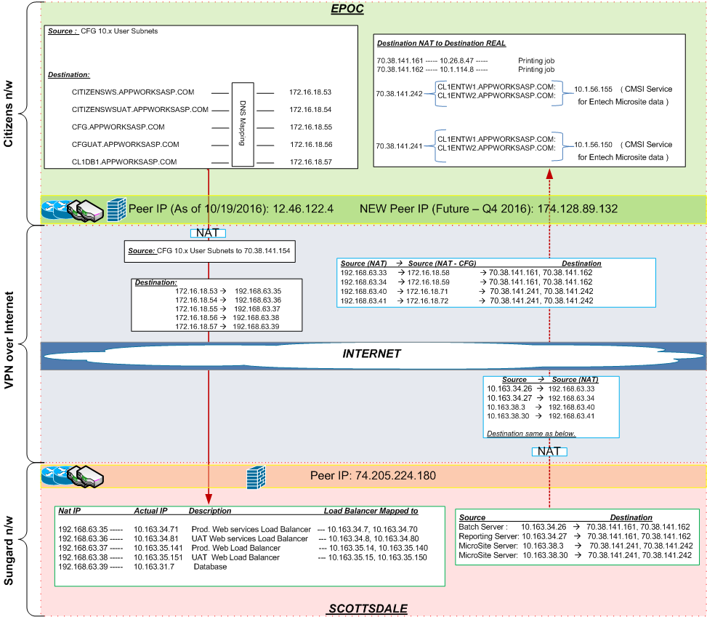
Network Infrastructure: EPOC <-> Scottsdale

Slide 11
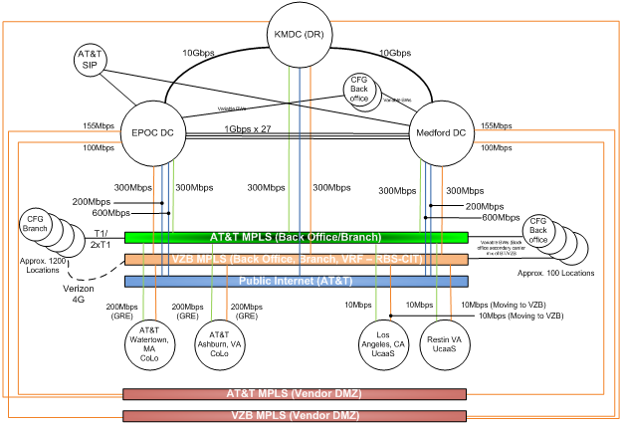
Current Network Infrastructure

